Slide 1
Project Update: Towards Digital Twins for Methane Emissions Forecasting and Scenario Analysis
Nicholas Tobias
04/06/2026
Supervisor: Prof. Paul Harris, Rothamsted Research

Slide 2
Quick (and possibly small) Progress Update
Unfortunately, little progress from last meeting due to exam season (which is now finished)
Dataset is being prepared:
Data aggregated (most likely w/ mean) to hourly level in conjunction to planned forecasting granularity
Data filtered for relevant catchments only (2, 4, 9)
Full gap analysis to be done (gap filling for soil moisture, etc to be checked as well)
Possibly… process-based models might be required
Once data is compiled, paper to be replicated: Gap-filling carbon dioxide, water, energy, and methane fluxes in challenging ecosystems: Comparing between methods, drivers, and gap-lengths.
Paper highlights critical methodologies for gap filling. In particular, RFRm outperforms all other models
As suggested, gap-filling for CO₂ to be checked for correlation with CH₄ as well
Comparison between results of differing models to be checked
Query from previous meet:
Is the raw data from NWFP still require some further post-processing with EddyPro and Tovi software? I’m pretty sure it can be used directly
Notes:
Zhu, S., McCalmont, J., Cardenas, L. M., Cunliffe, A. M., Olde, L., Signori-Müller, C., Litvak, M. E., & Hill, T. (2023). Gap-filling carbon dioxide, water, energy, and methane fluxes in challenging ecosystems: Comparing between methods, drivers, and gap-lengths. Agricultural and Forest Meteorology, 332. https://doi.org/10.1016/j.agrformet.2023.109365

Slide 3
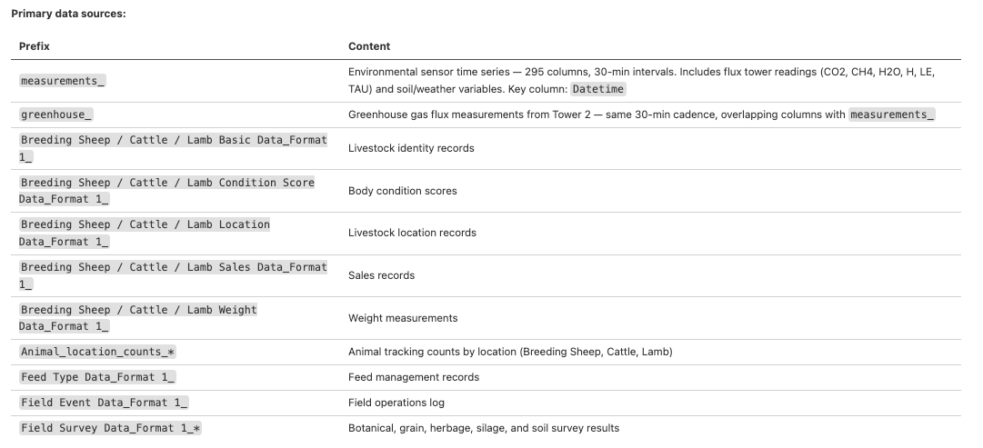
Dataset Preparation
Planned Features of aggregated dataset
Notes:
Zhu, S., McCalmont, J., Cardenas, L. M., Cunliffe, A. M., Olde, L., Signori-Müller, C., Litvak, M. E., & Hill, T. (2023). Gap-filling carbon dioxide, water, energy, and methane fluxes in challenging ecosystems: Comparing between methods, drivers, and gap-lengths. Agricultural and Forest Meteorology, 332. https://doi.org/10.1016/j.agrformet.2023.109365

Slide 4
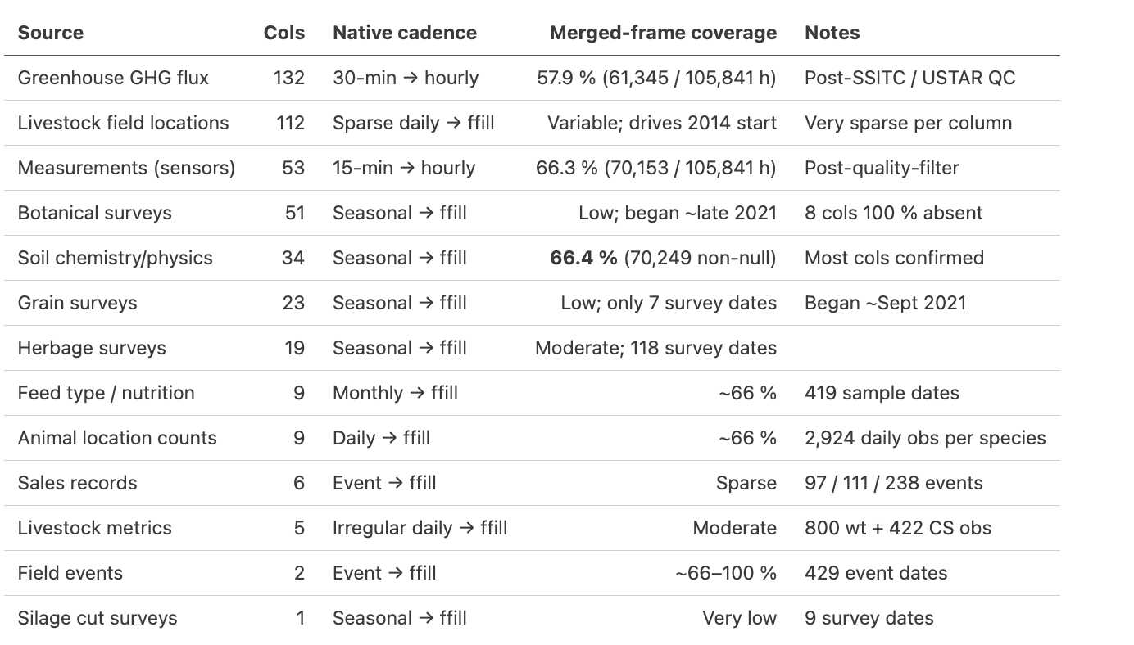
Dataset Preparation
An early version of consolidated dataset has been generated, testing to commence this week
Notes:
Livestock Location
Surveys & Botanical Surveys will not be usable for forecasting
Uncertainty to be affected by missing components -- something to be considered
Consider soil moisture and vegetation

Slide 5
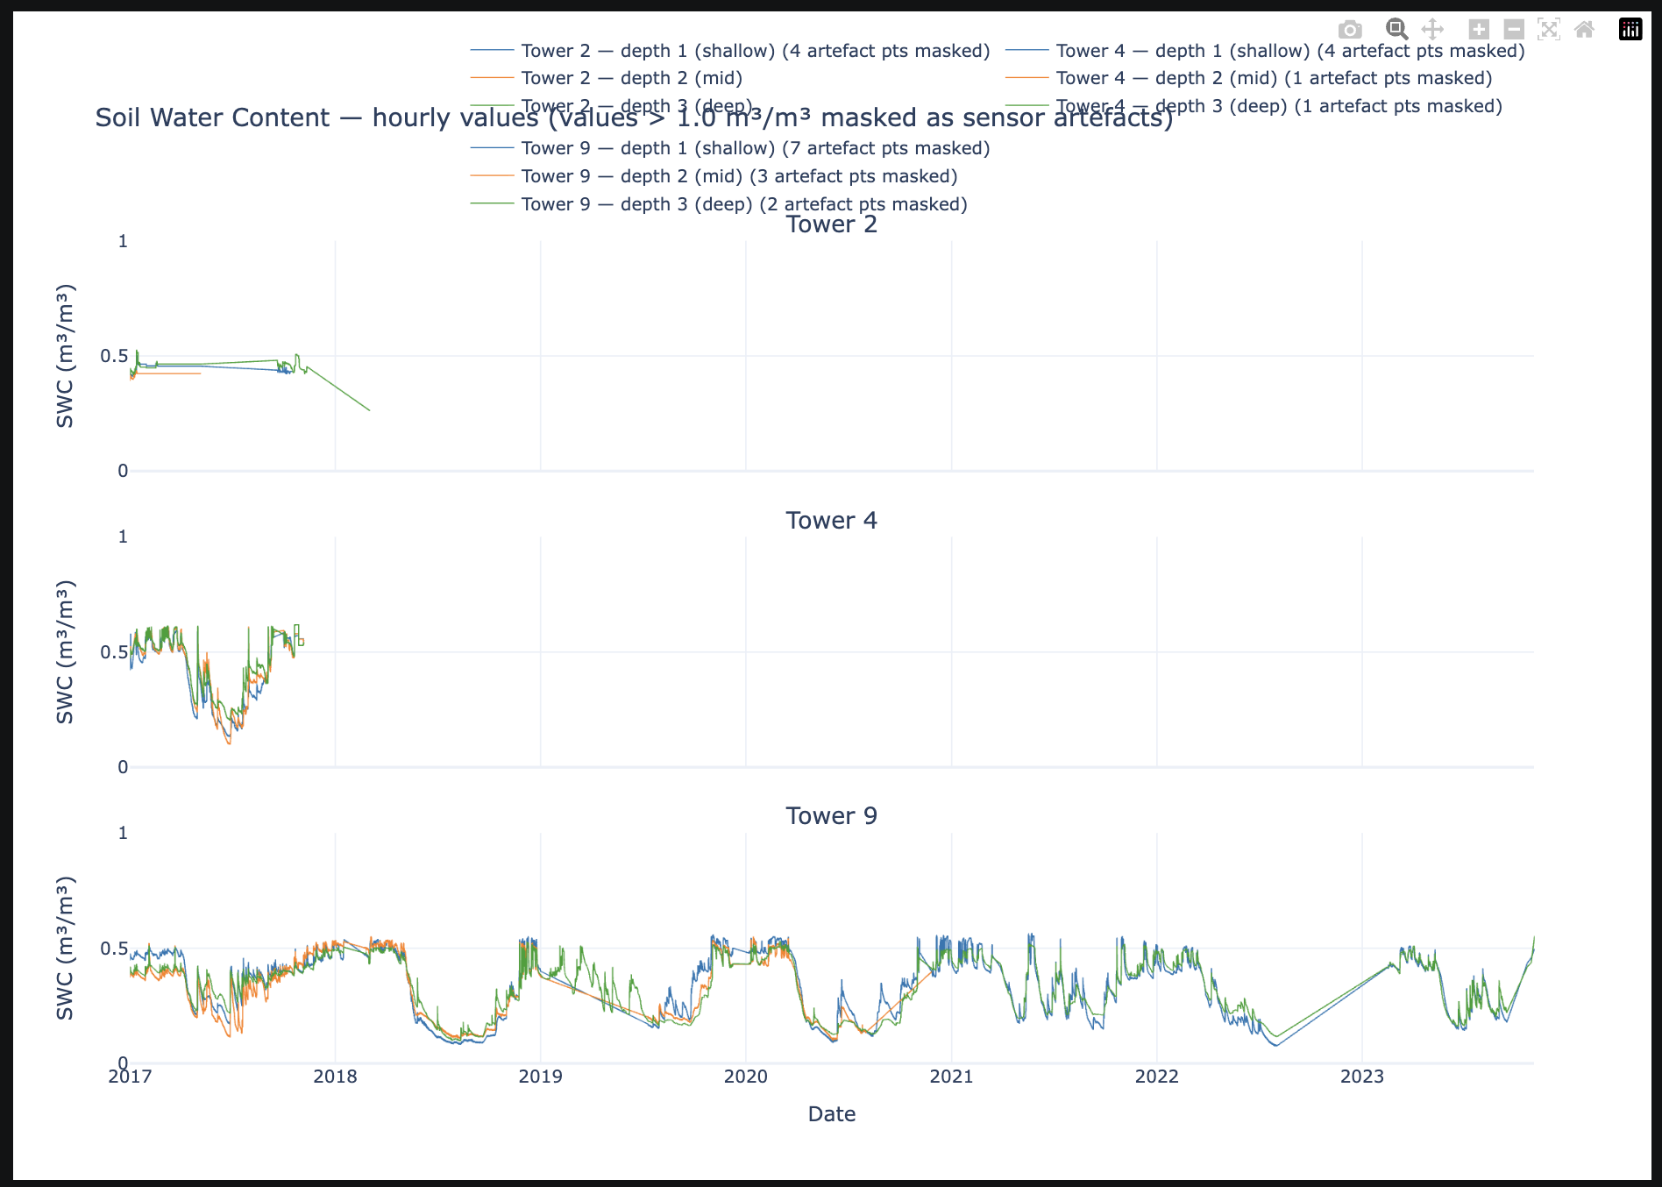
Questions
1. Soil Moisture for Catchment 2 & 4 only have data for 2017 (Data from EC GHG, SMS data seems fine). This shouldn’t have an impact as we can infer data from Soil Moisture Station Data instead right?
Notes:
EC will capture a richer, more holistic emissions signal over IPCC Tier 1 static emission factors, improving model informativeness at farm scale

Slide 6
Notes
CO2 flux can be related to CH4, need to perform
Forecasting Granularity to be at hourly level
Only Relevant Catchments to be kept
Extrapolation from tower to field level measurement not important
…
Notes:
EC will capture a richer, more holistic emissions signal over IPCC Tier 1 static emission factors, improving model informativeness at farm scale

Slide 7
Quick Progress Update
Data has been downloaded and compiled across timeframes (2017 – 2024) for all catchments.
All data has been downloaded and compiled, but expected useful ones: {meteorological & soil moisture measurements, GHG EC data, field events data}
At the moment, all catchments are kept, though EC sensors are only at 2, 4, and 9 (EDA so far is only for relevant catchments)
Early Exploratory Data Analysis is being done, so far:
EC GHG data has massive gaps (approx. 55 – 87% missing for CH4 across towers)
Tower 2 in particular only have 1-year data available
Towers 4 and 9 are more manageable. Still requires study on gap filling, however.
Meteorological & soil moisture measurements also have significant gaps, though still require further analysis.
Field Events and Livestock are still being explored, number of livestock per catchment and its feed might be useful.
Gap Filling approaches and FCH₄ drivers are being explored
Most likely, methodology will be MDS, RFR & XGB as it is most effective (Zhu. S, et al. 2023)
Notes:
Zhu, S., McCalmont, J., Cardenas, L. M., Cunliffe, A. M., Olde, L., Signori-Müller, C., Litvak, M. E., & Hill, T. (2023). Gap-filling carbon dioxide, water, energy, and methane fluxes in challenging ecosystems: Comparing between methods, drivers, and gap-lengths. Agricultural and Forest Meteorology, 332. https://doi.org/10.1016/j.agrformet.2023.109365

Slide 8
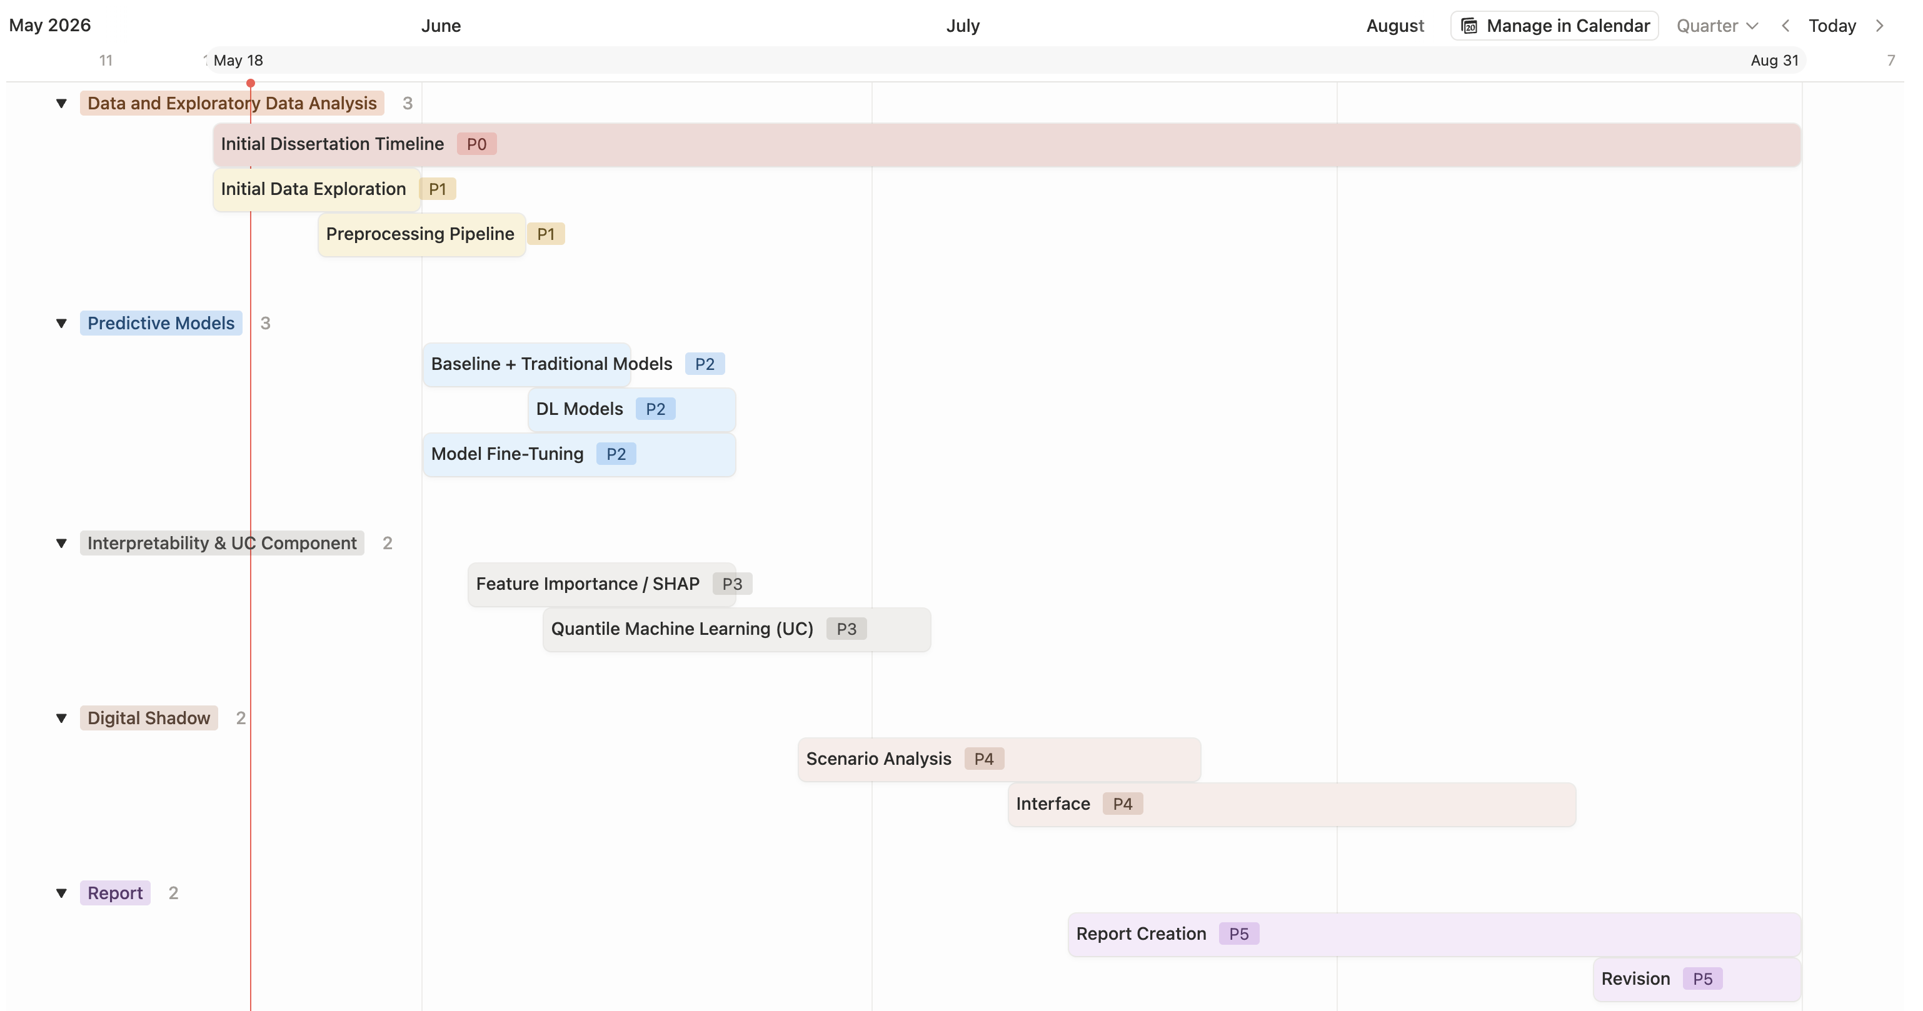
Full Timeline
Notes:
Data Preprocessing will take much longer
Interface wouldn't matter much
Feature Importance will be very quick.

Slide 9
Full Timeline
Data Completeness and EDA [May 18th - June 7th]
Outcome: Prepared Dataset for AI & ML Prediction
Watchouts: Gaps in EC and Testing with Gap-Filing approaches as suggested
Forecasting Models Testing [June 1st - 21st] (Granularity: Catchment – Date – Hour (?))
Outcome: Tabular analysis containing individual model performance & training time and pre-trained models
Models to be tested:
Baseline : Seasonal Mean, ARIMA
Traditional ML : Random Forest, Gradient Boosting, XGBoost
Deep Learning : RNN, LSTM, TFT
Watchouts:
CV methodology to be tested
Feature engineering for time series forecasting to be tested
Interpretability & UC Component [June 4th - Jul 4th]
Outcome: Feature Importance and Prediction Intervals for each models (or perhaps the best model)
Required Reading :
Quantile Machine Learning
Prediction & Confidence Intervals
Digital Shadow Component [June 26th - Aug 16th]
Outcome: Frontend Component (Streamlit or similar web applications)
Watchouts:
Expected to be time consuming due to number of scenarios and generation of frontend elements
Report Writing [Jul 14th - Aug 31st] with Final Revisions between Aug 18th to 31st
Notes:
Forecasting Granularity to be hourly at the moment.

Slide 10
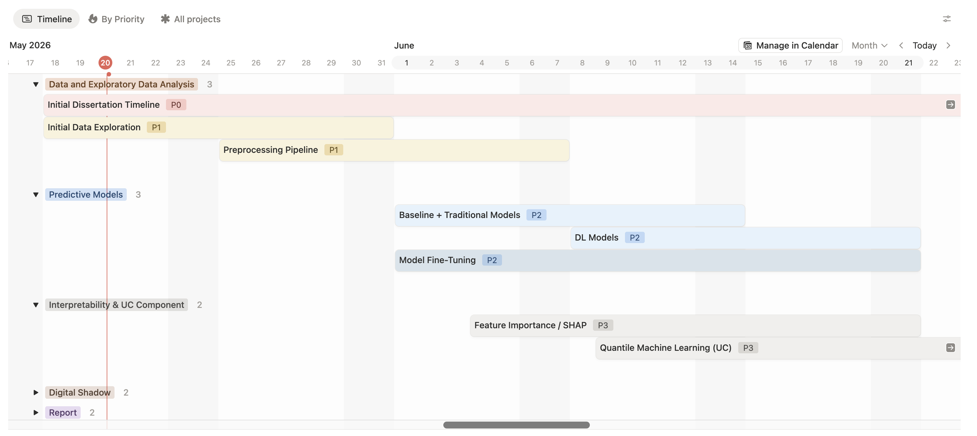
Current Priorities
1. Data Completeness and EDA [May 18th - June 7th]
Outcome: Prepared Dataset for AI & ML Prediction
Watchouts: Gaps in EC and Testing with Gap-Filing approaches as suggested
2. ML forecasting models testing to start at June 1st – 21st in parallel once dataset is ready
→ Granularity is still uncertain, could be hourly or daily

Slide 11
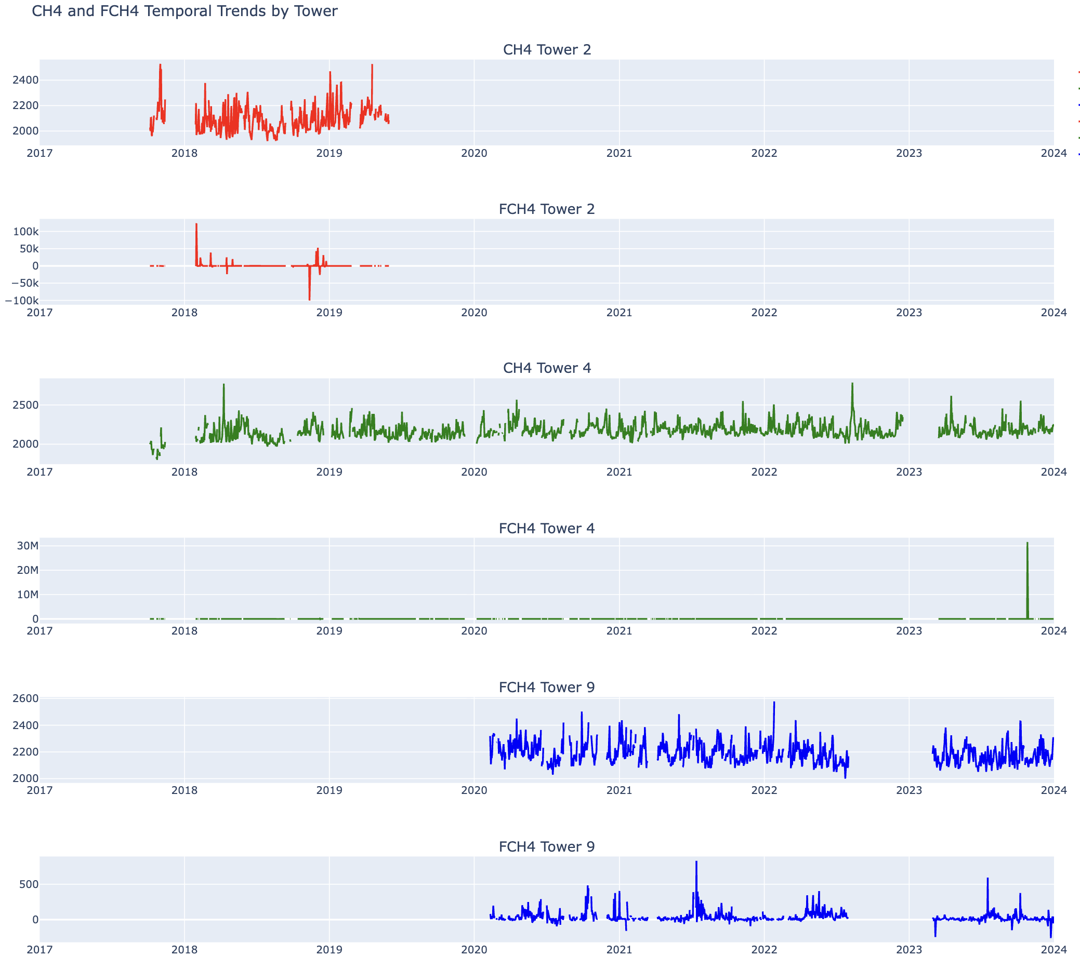
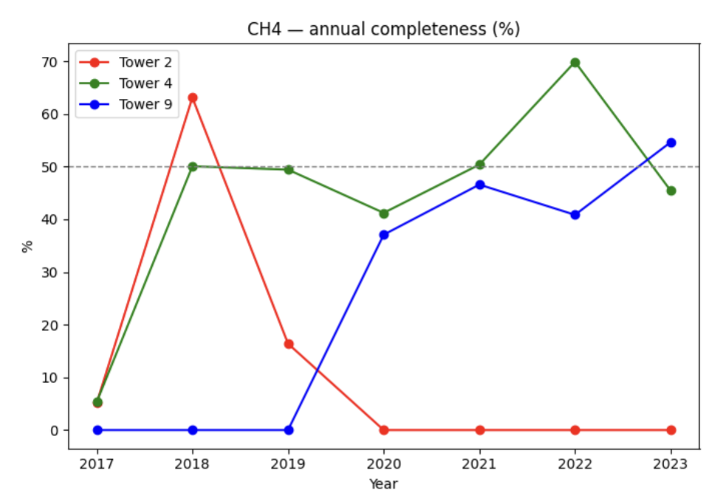
Early EDA
1. EC Greenhouse Gas has significant gaps for CH4 with <= 50% completeness in average
All EC towers require gap filling
Outliers exist, can be filtered out via “FCH4_SSITC_TEST_1_1_1”
Tower 2 (Red) especially worrisome due to only having 1-year usable data.
→ Model treatment might be evaluation by year quarters in 2018 alone?

Slide 12
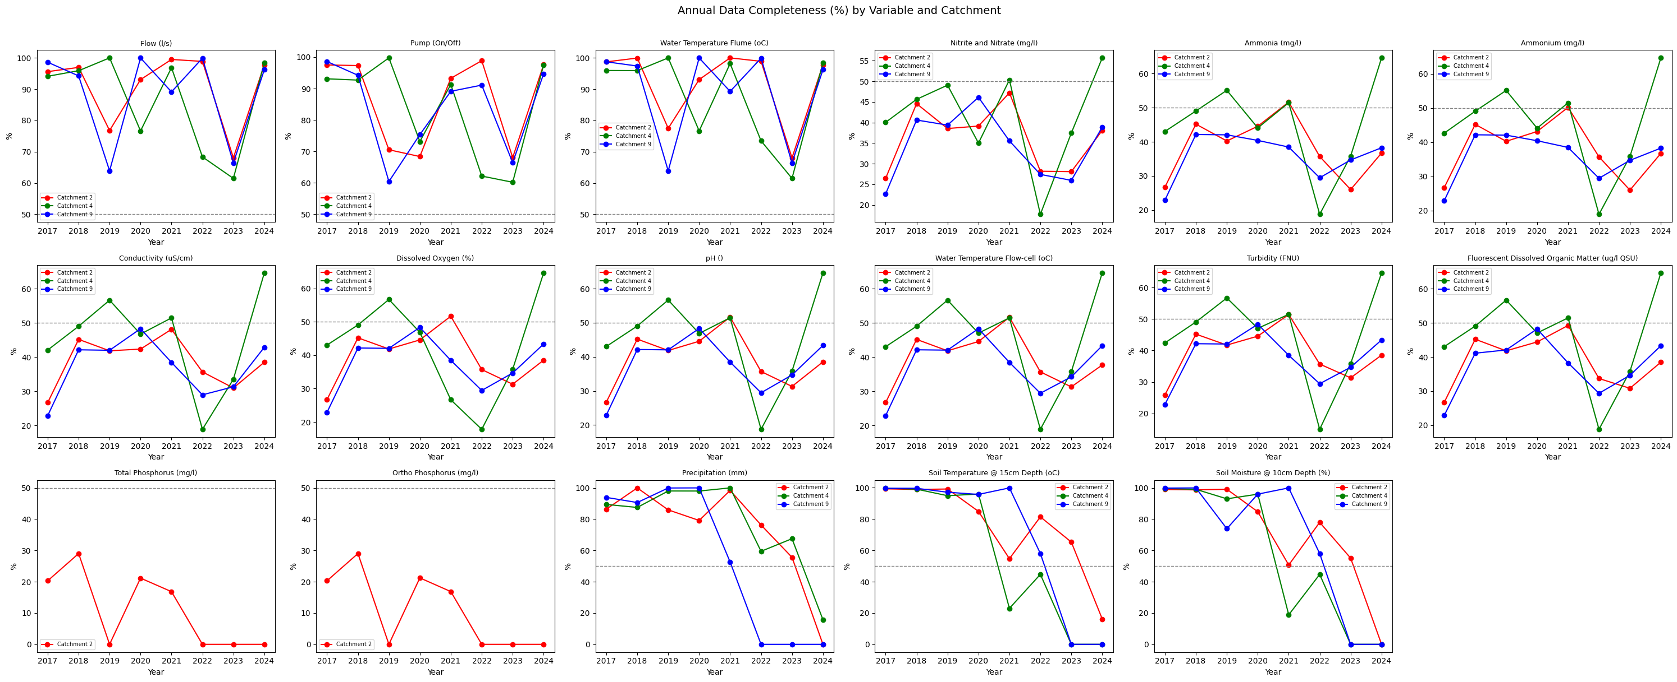
Early EDA
2. Meteorological Data Completeness <potential drivers still being explored>
Available data: {flow, pump, water temperature, nitrite and nitrate, ammonia, ammonium, conductivity, dissolved oxygen, pH, water temperature flow cell, turbidity, fluorescent dissolved organic matter, phosphorus, precipitation, soil temperature, and soil moisture}

Slide 13
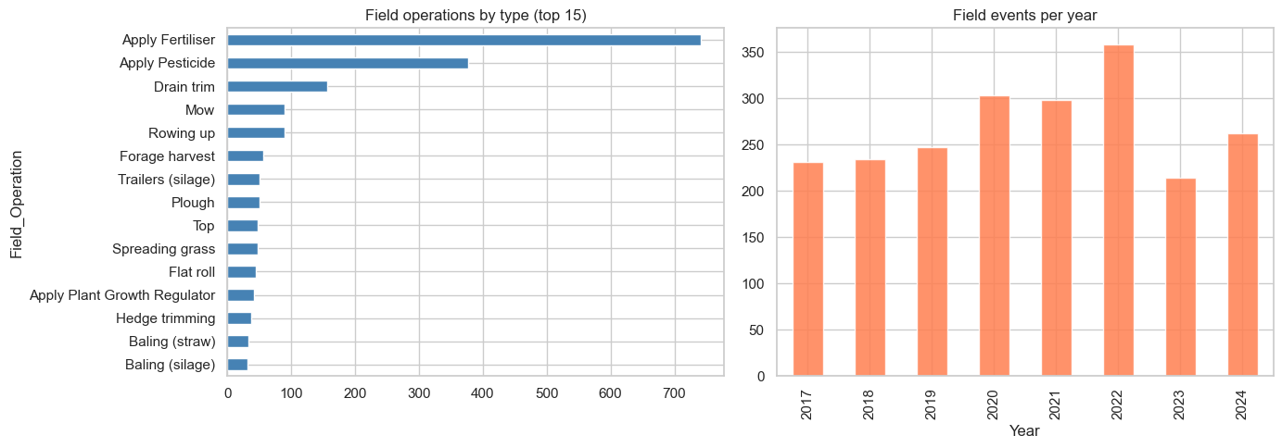
Early EDA
3. Field Data <WIP>

Slide 14
Performed Reading
Zhu, S., McCalmont, J., Cardenas, L. M., Cunliffe, A. M., Olde, L., Signori-Müller, C., Litvak, M. E., & Hill, T. (2023). Gap-filling carbon dioxide, water, energy, and methane fluxes in challenging ecosystems: Comparing between methods, drivers, and gap-lengths.
This paper highlights critical methodologies for gap filling. In particular, RFRm outperforms all other models
RFRm uses multiple drivers (such as wind speed, net radiation, soil temperature, etc) but are mostly dominated by wind speed (WS), followed by auxiliary drivers (AUX), and other environmental features (OEF).
However, performance from R² is < 0.1 for all models i.r.t FCH₄, highlighting the challenge of this task
Zhu, S., Olde, L., Lewis, K., Quaife, T., Cardenas, L., Loick, N., Xu, J., & Hill, T. (2023). Eddy covariance fluxes over managed ecosystems extrapolated to field scales at fine spatial resolutions.
Paper highlights the use of satellite imagery to extrapolate EC data (not FCH₄ though) from tower level to field level with XGBoost
Notably, the paper highlights farm management activities as a key unresolved challenge that causes abrupt and unanticipated changes to flux
Is extrapolation from tower to field level a required step at this stage however?
Cardenas, L. M., Olde, L., Loick, N., Griffith, B., Hill, T., Evans, J., Cowan, N., Segura, C., Sint, H., Harris, P., McCalmont, J., Zhu, S., Dobermann, A., & Lee, M. R. F. (2022). CO2 fluxes from three different temperate grazed pastures using Eddy covariance measurements.
Paper outlines relationship between pasture type and time of the year in predicting eddy covariance fluxes. Other drivers mentioned: soil water content, soil temperature, PPFD, day length, grazing intensity, etc
Also outlined the site level data processing of raw EC data with EddyPro and Tovi
A statistical modelling approach with daily gaussian model
Notes:
There might be a relationship between CO2 and CH4, imputing CO2 might be beneficial as well.

Slide 15
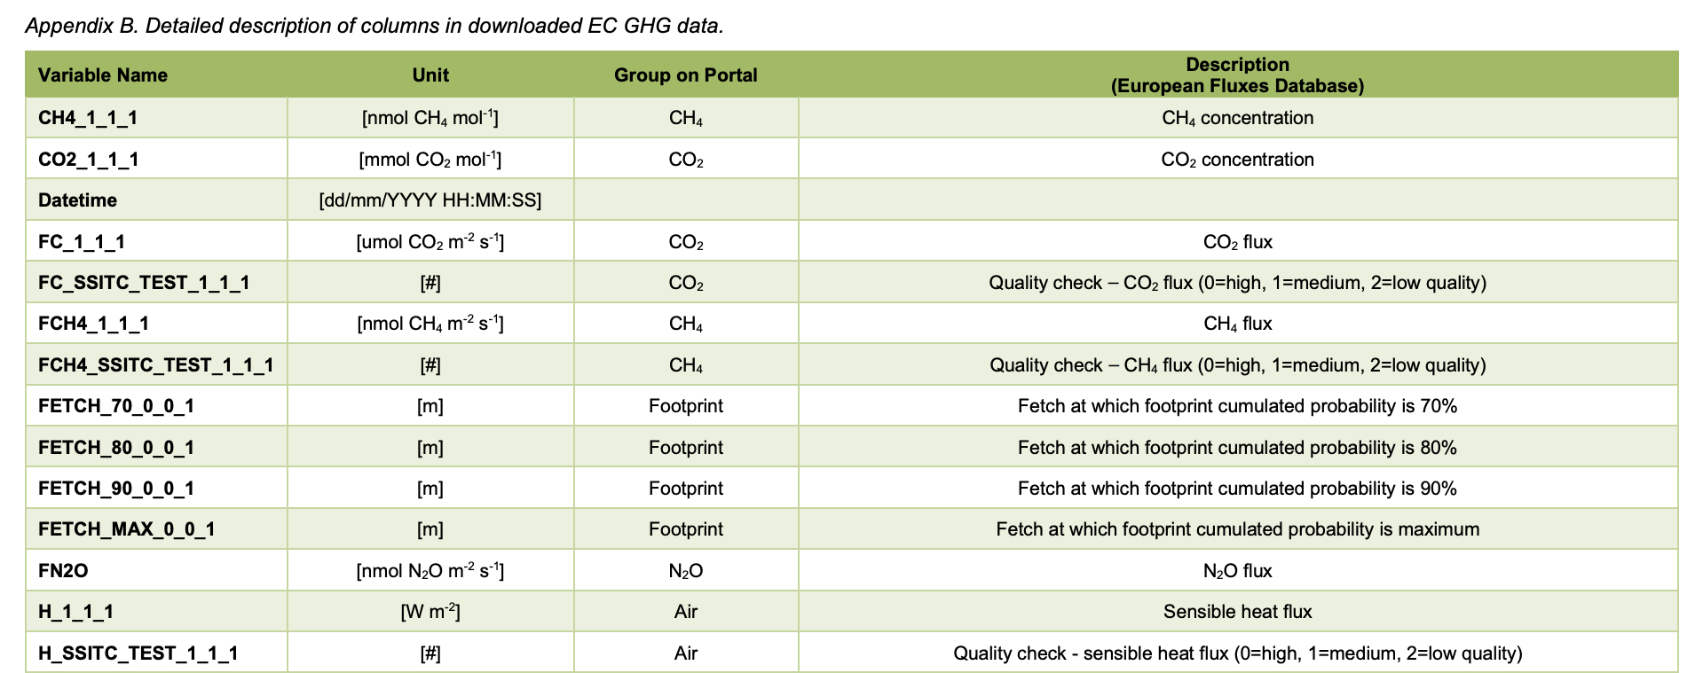
Questions
1. Target Variable? Which matters more? FCH4 or CH4 (Figure from data guide)
Notes:
EC will capture a richer, more holistic emissions signal over IPCC Tier 1 static emission factors, improving model informativeness at farm scale

Slide 16
Questions
2. Gaps in the dataset needs to be handled critically. Method of handling it seems to be gap filling via RFRm. Are there any suggestions?
3. Is the raw data from NWFP still require some further post-processing with EddyPro and Tovi software? Not sure
4. Is extrapolation from Tower level measurement to Field level measurement a required process? No
5. Utilization of livestock data (Animal location, feed type, and perhaps others) seems beneficial in predicting emissions (though I am still very early in the EDA and It seems data is on daily level at best). Would you have any suggestions to this idea? Covered
6. Gap filling methods as suggested by Zhu et al, 2023 has an R² score of < 0.1 for all methods in regard to FCH₄. Would you have any suggestions?
(maybe a stupid question), but it seems that truly forecasting FCH₄ requires first exploring suitable means of gap filling EC data. Could you confirm?
7. What would be your recommendation in handling multiple datasets with differing granularity?
→ My (current) intended approach : aggregate to hourly (at best) or daily (at worst)
Notes:
EC will capture a richer, more holistic emissions signal over IPCC Tier 1 static emission factors, improving model informativeness at farm scale

